Slide 1


Presentation
on
“RTO Management System”
Presented By-
AKANSH BISEN(219013)

Slide 2
Points to be discussed
Introduction
Motivation
Objective
Technology Used
UML Diagram
Screenshots
System Specification
Conclusion
References

Slide 3
Introduction
RTO is a web system that provides the function and features to authenticate and identify the users and provide then with easy, intuitive, personalized and user-customizable web-interface for facilitating access to information and services that are of primary relevance and interests to the users.

Slide 4
motivation
Now a days the system in the RTO has the process of making the paper report in any department which is done manually which in turn increases the time requirement.
Due to pandemic, the RTO faces multiple difficulties for communicating as well as sharing required resources to the users and RTO staffs.
Users and RTO Staff has to go through various procedure to communicate with the RTO in order to change profile or vehicle related functions and details.

Slide 5
objective
The online RTO Management Web Application is intended to provide complete solution for Citizens, RTO Staff through a single Gateway using internet. It will enable Citizens and RTO staff to access information, modify information online without visiting the RTO office physically.
RTO (Regional Transport Office) system is an application that is designed for the RTO for the process of registration of vehicles and issuing Driving license, Learning License, Owner Ship Transfer based web Application. RTO Information System is an online information source developed for Road Transport Authority to facilitate the users in applying for various licenses and registrations.

Slide 6
Technology used
Front End : React Js
Back End : Spring Boot
Database : MySQL

Slide 7
Uml diagrams

Slide 8
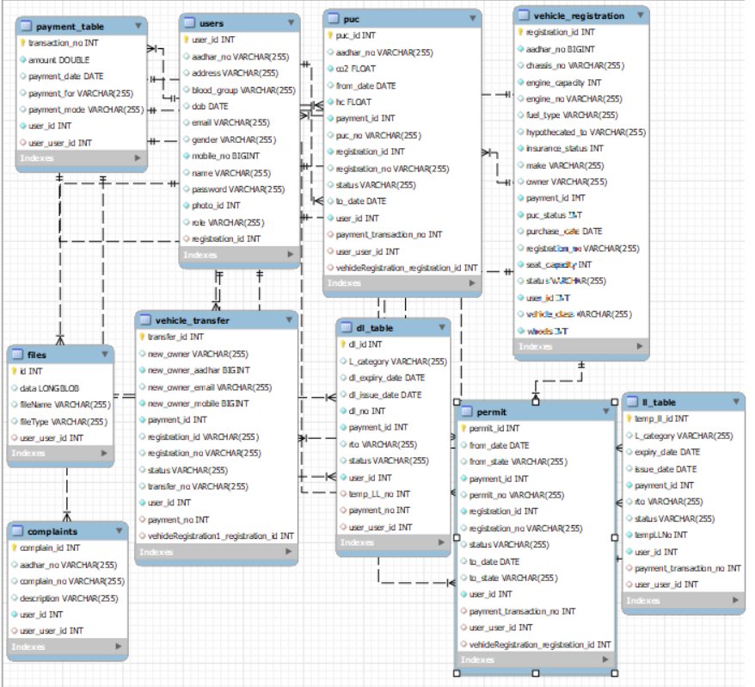

Slide 9
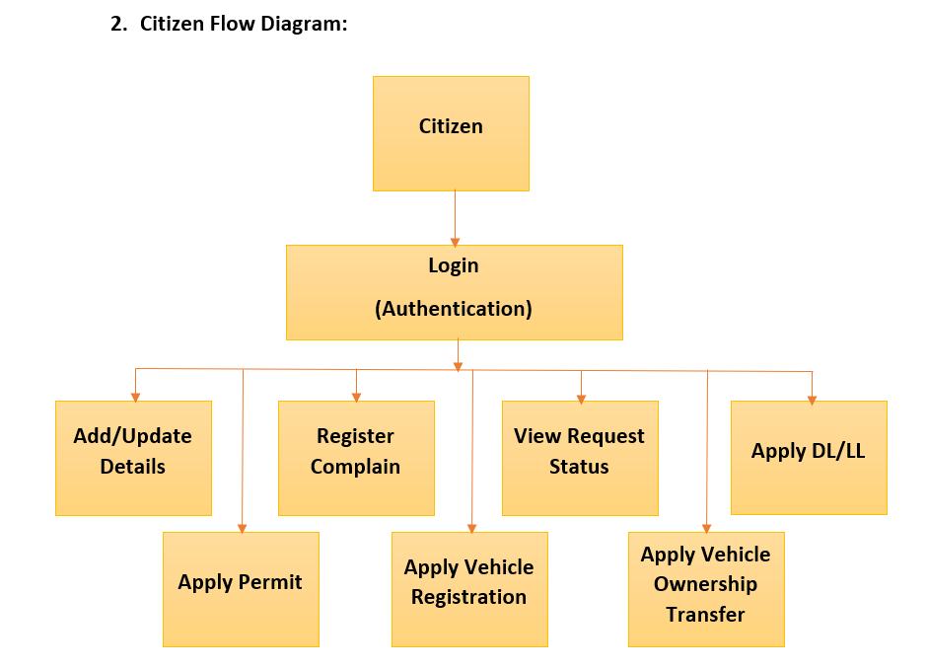
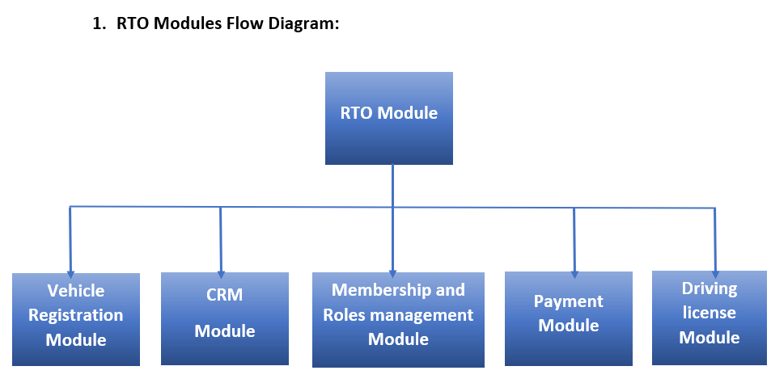

Slide 10
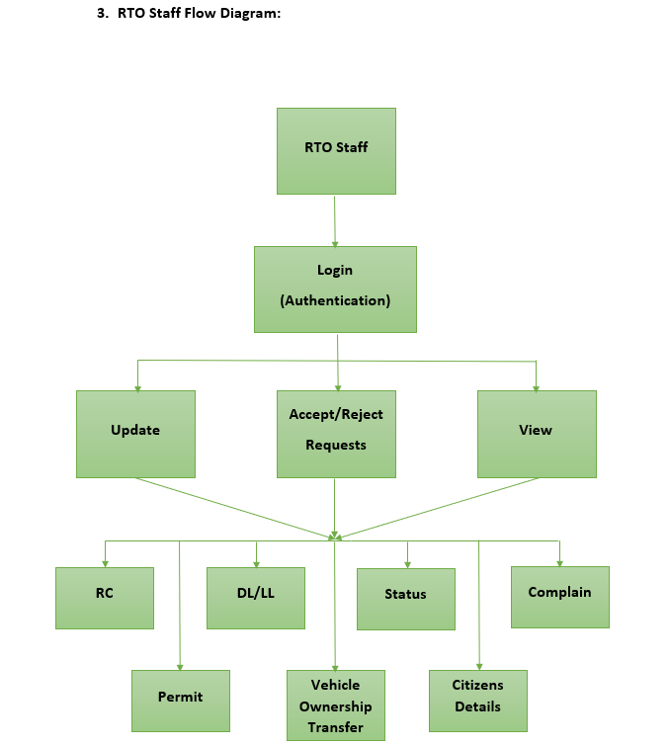

Slide 11
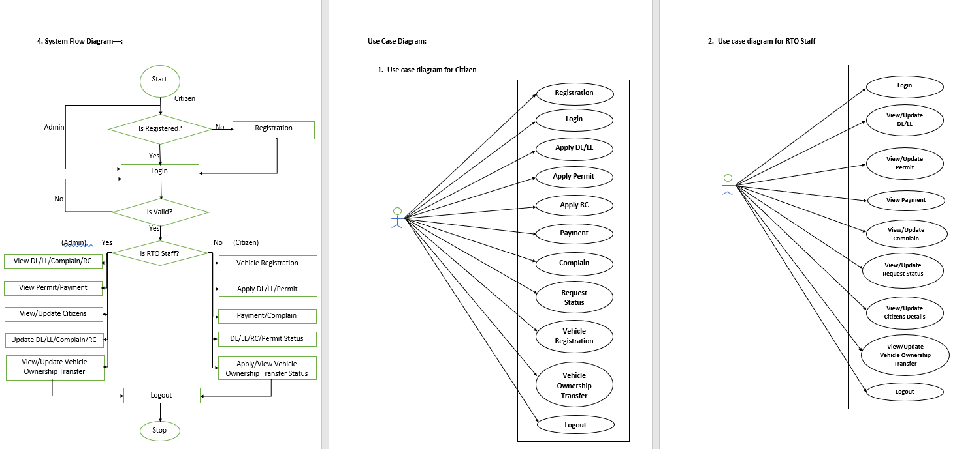

Slide 12
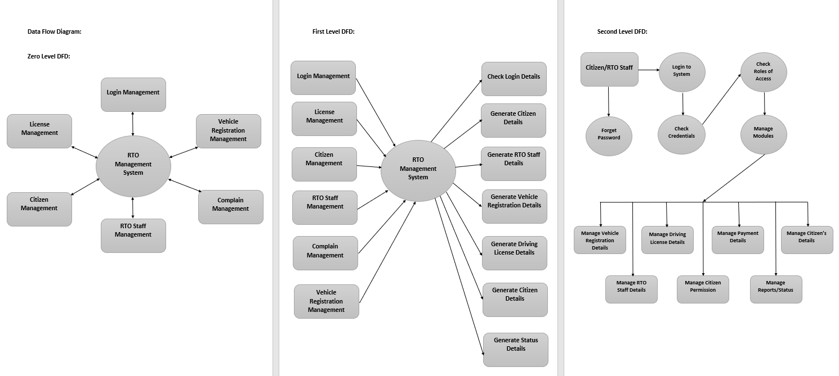

Slide 13
screenshots

Slide 14
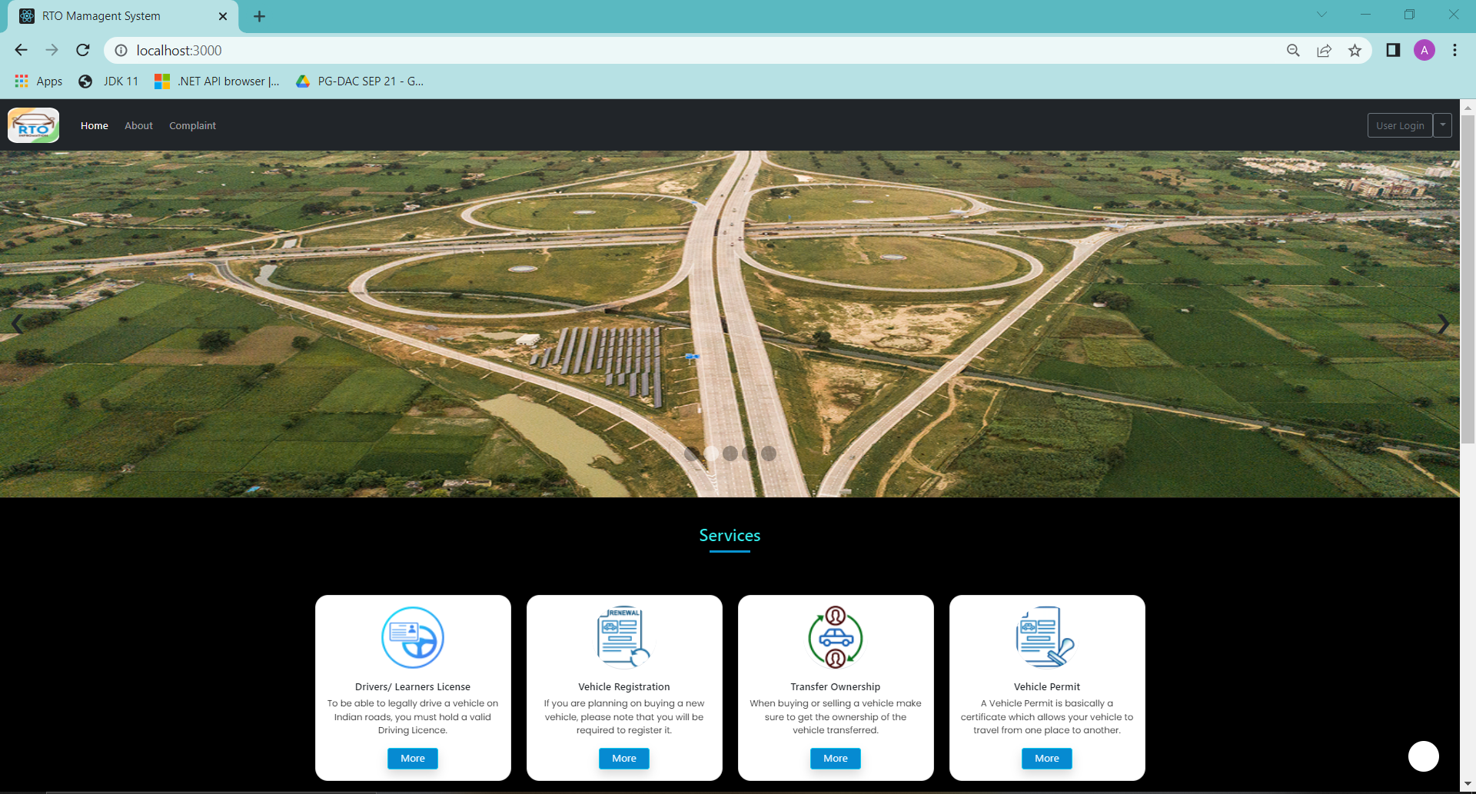

Slide 15
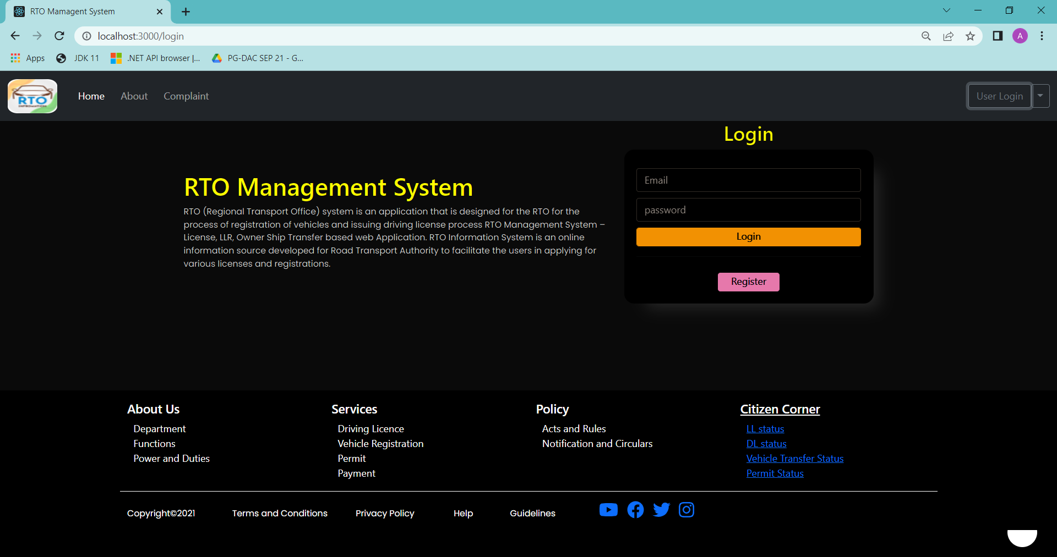
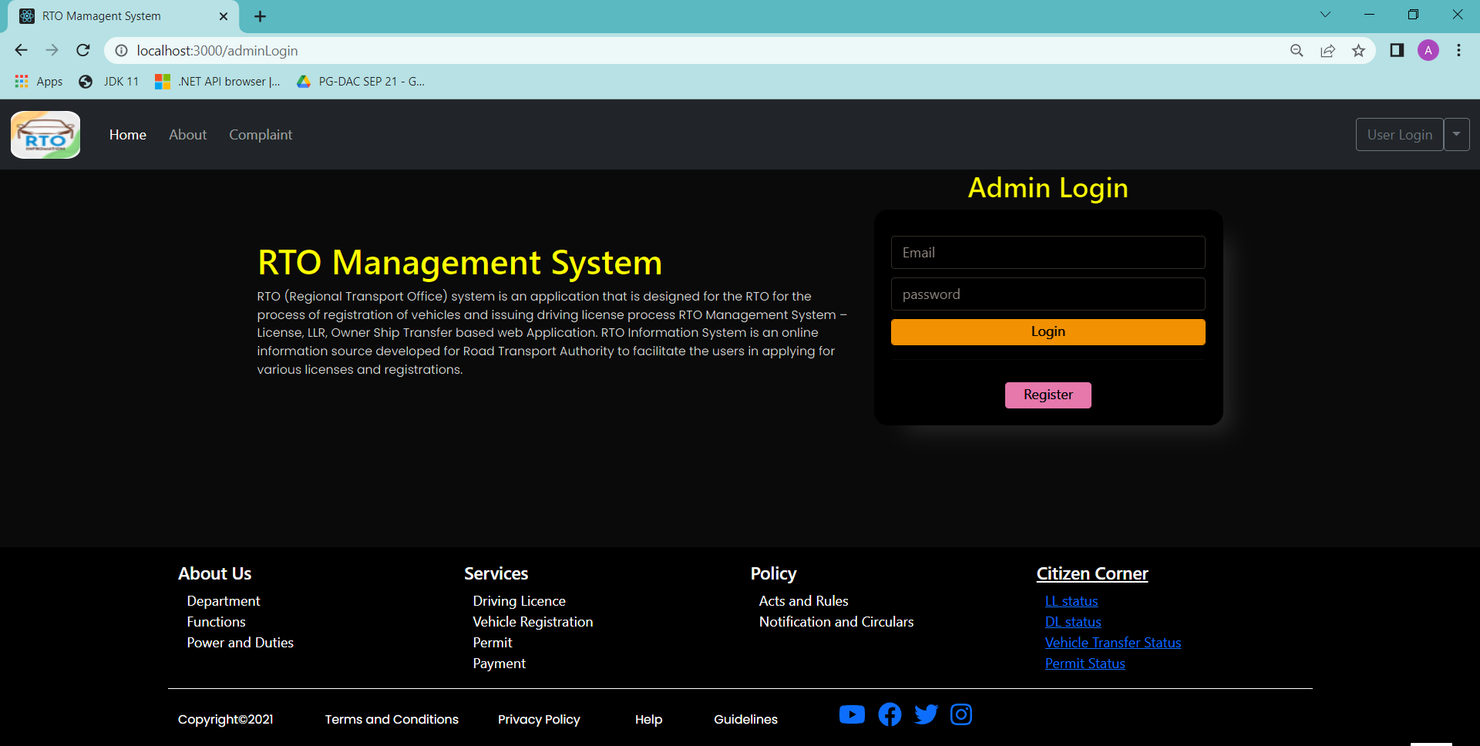

Slide 16
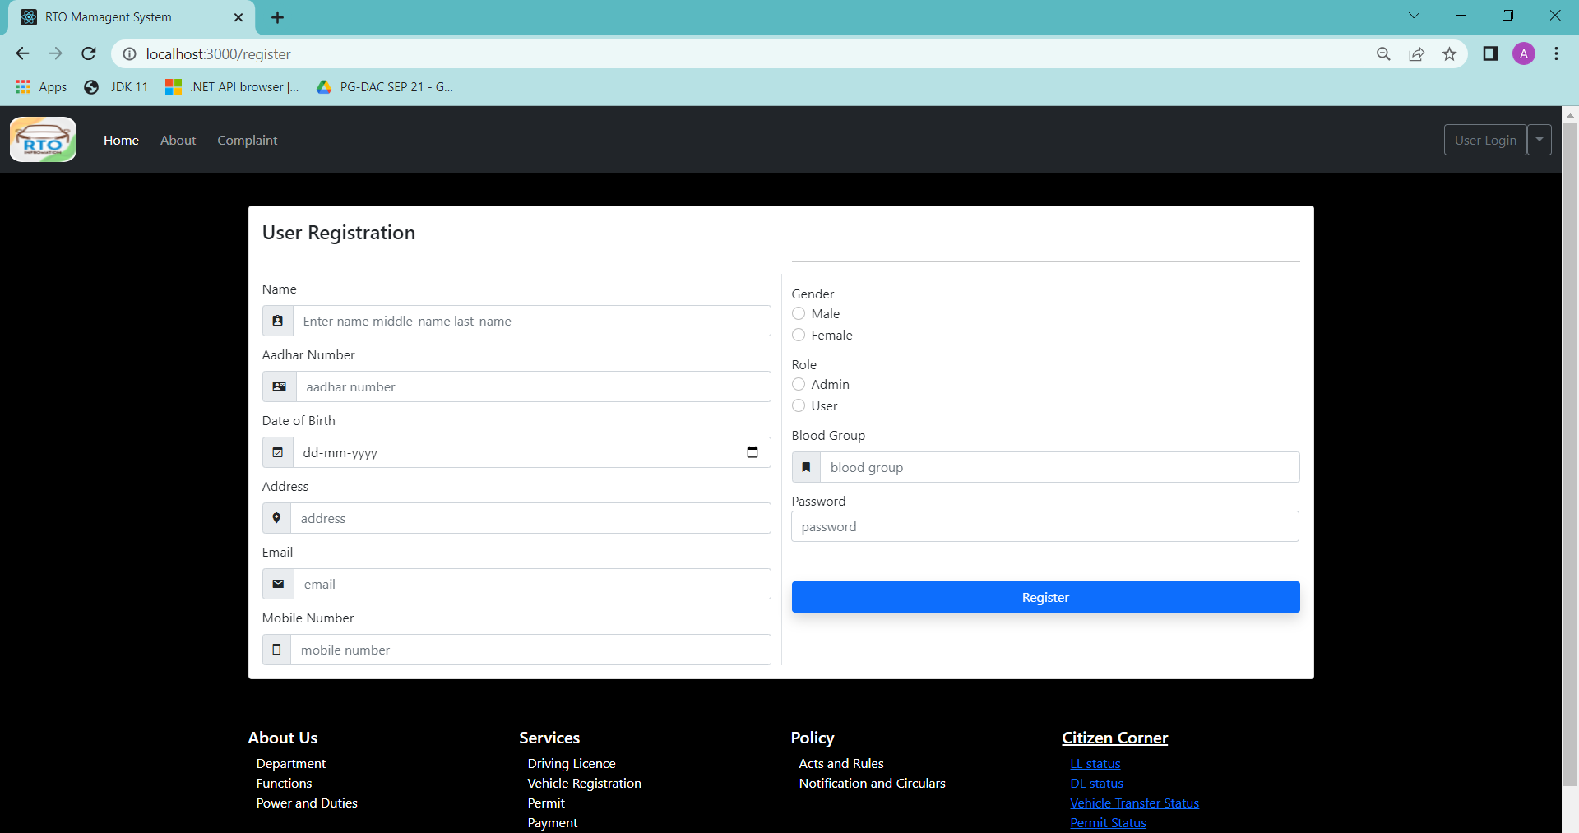

Slide 17
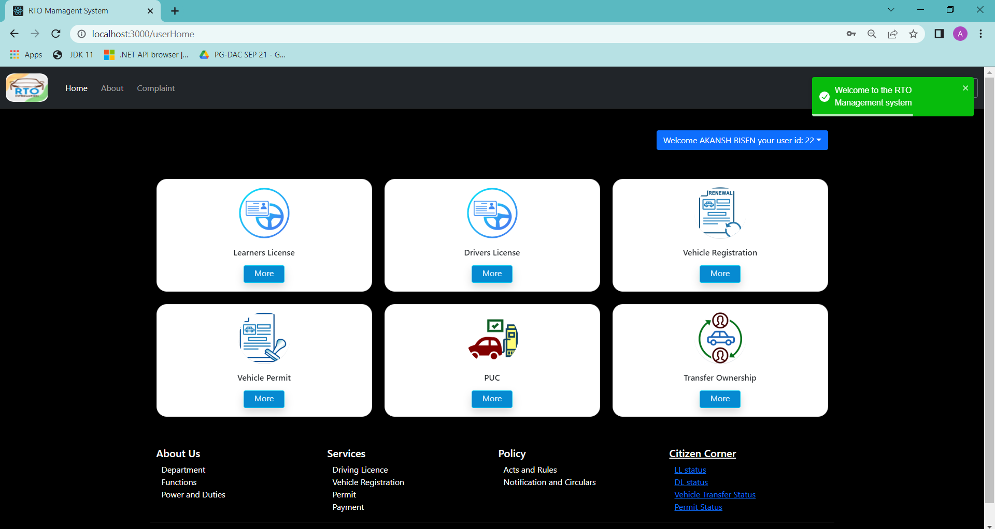
User Dashboard

Slide 18
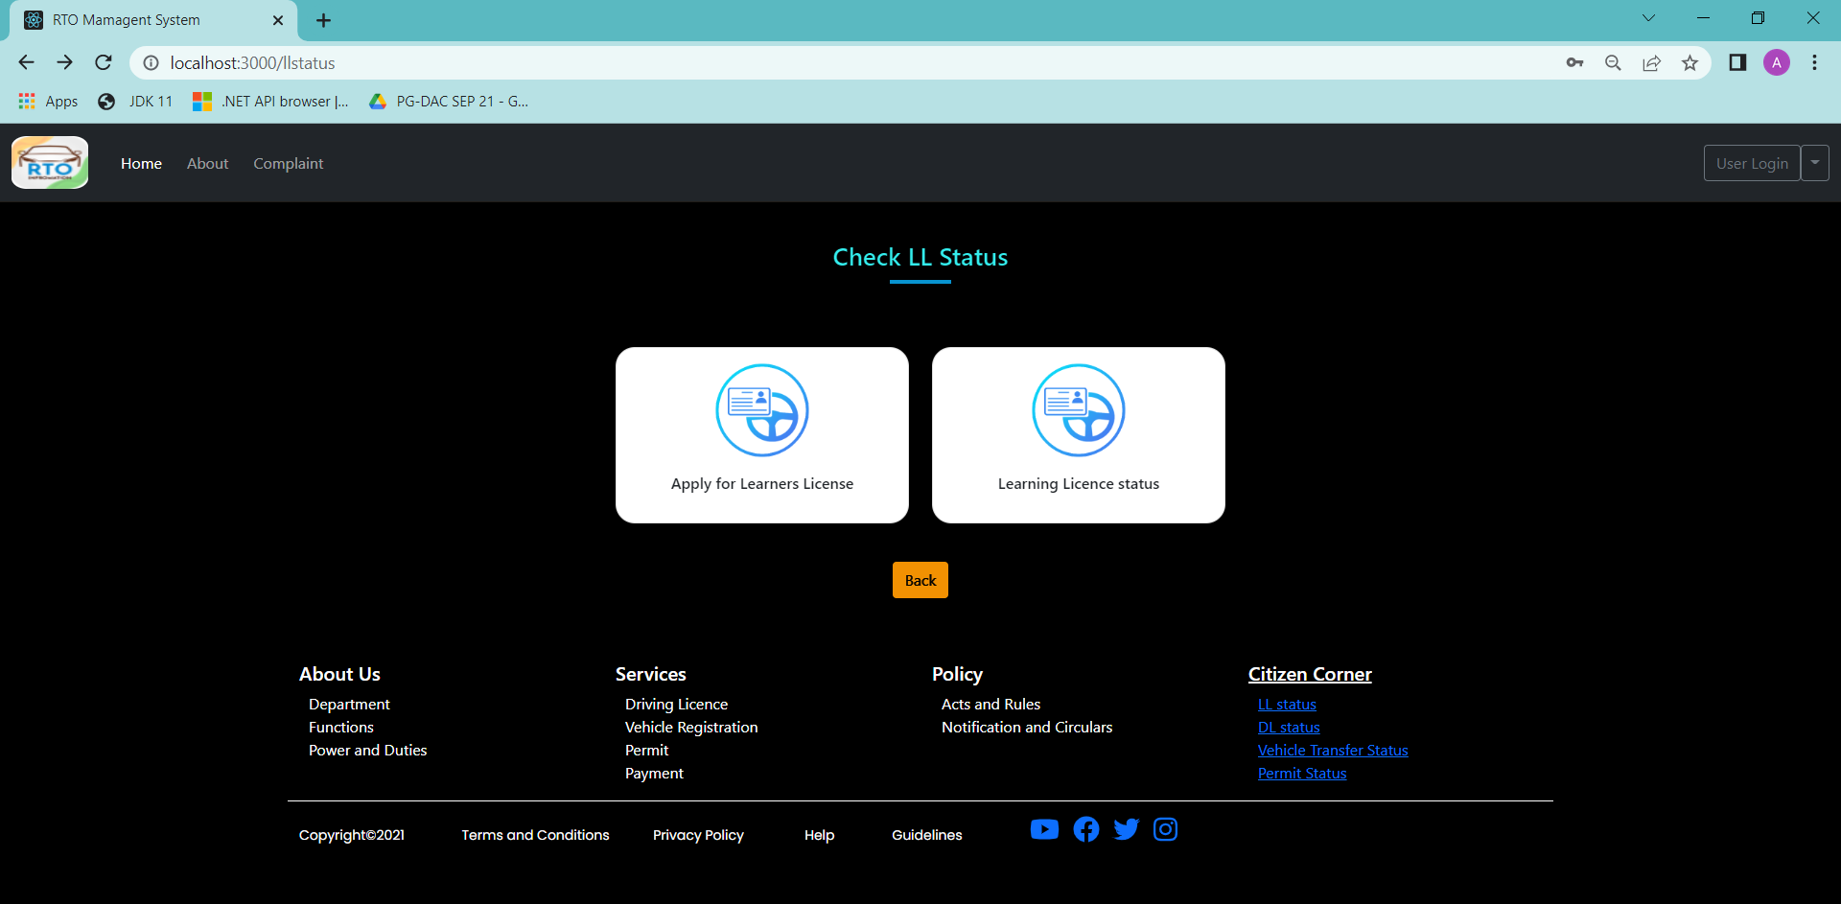
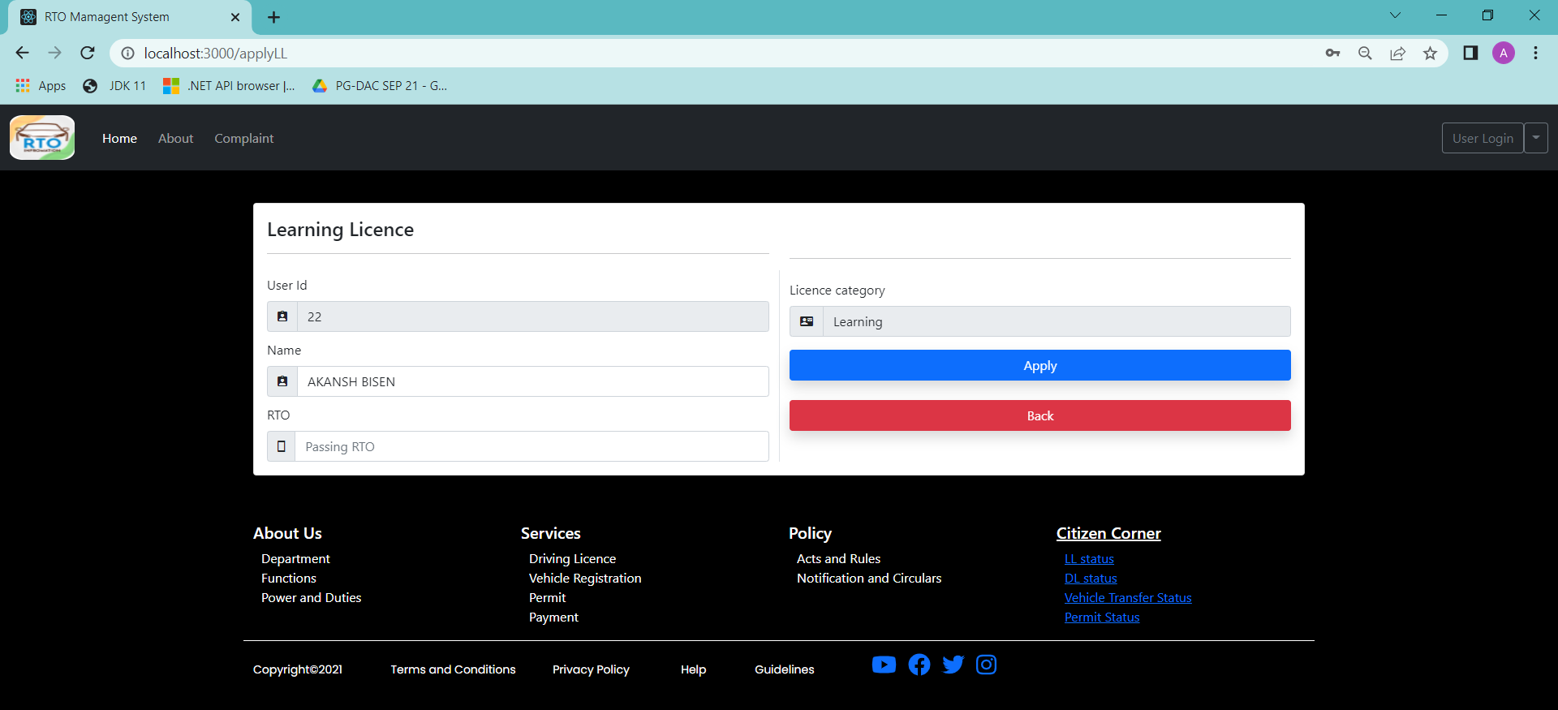

Slide 19

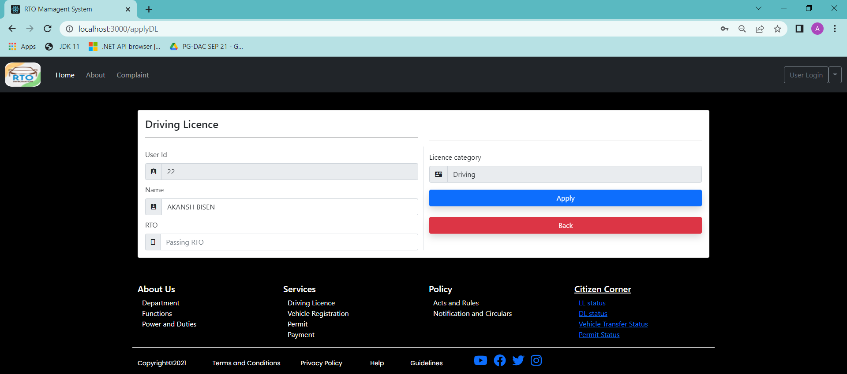

Slide 20
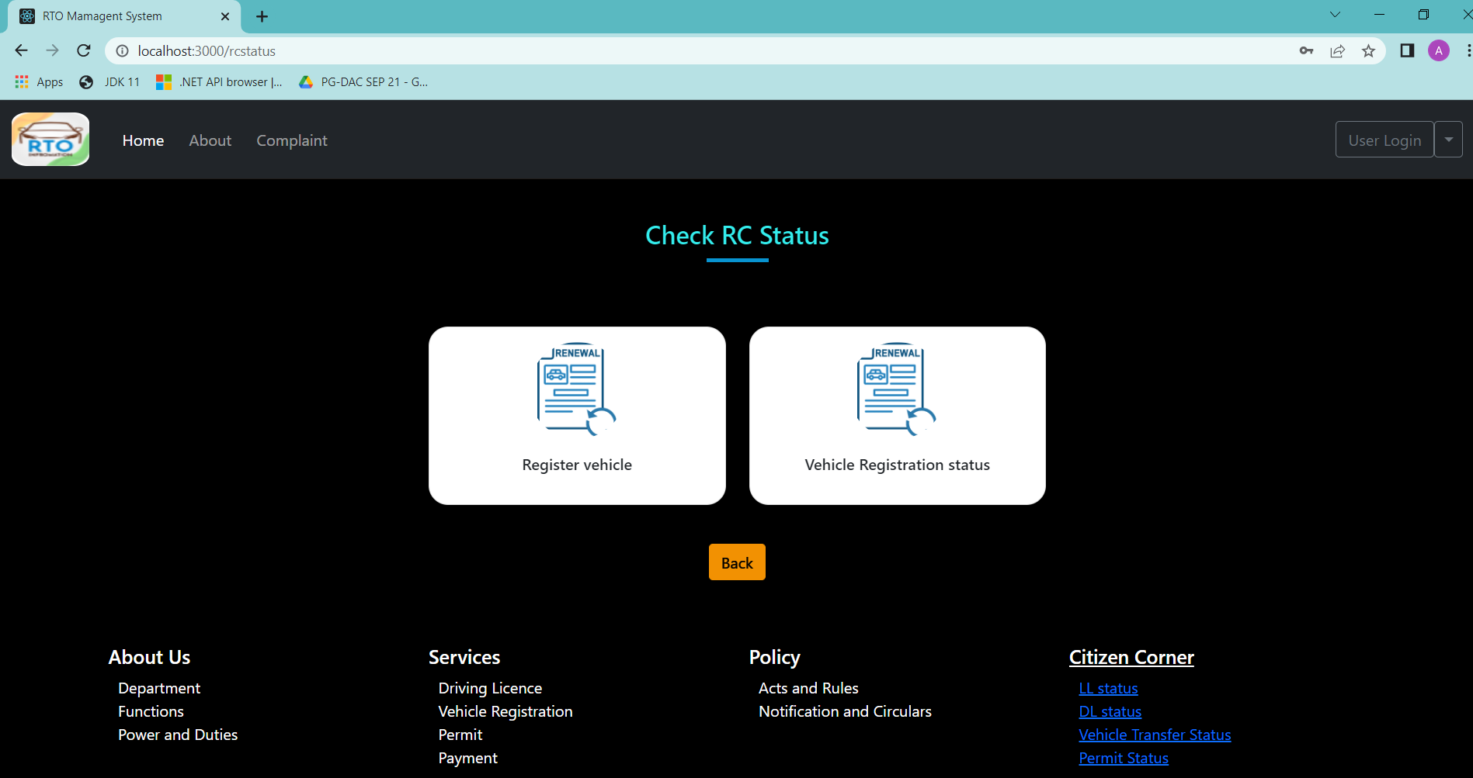
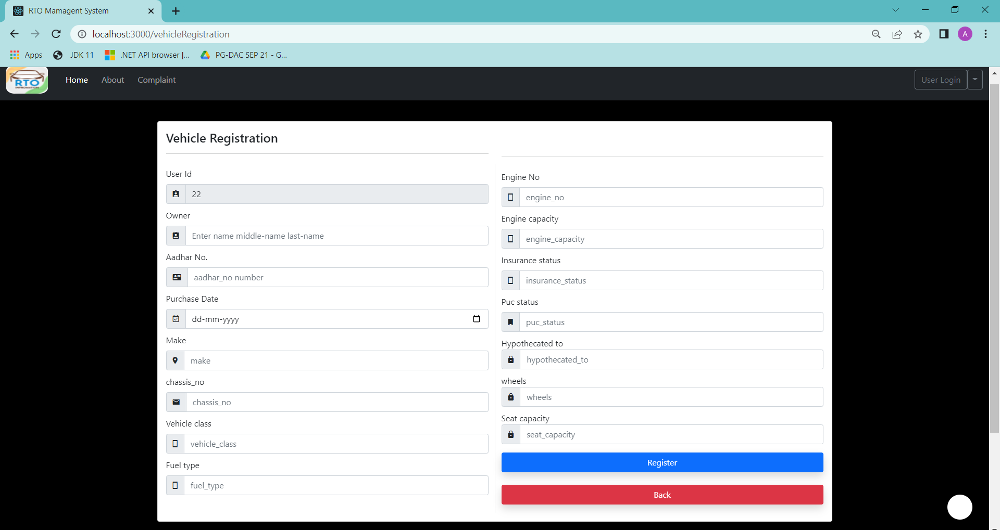

Slide 21
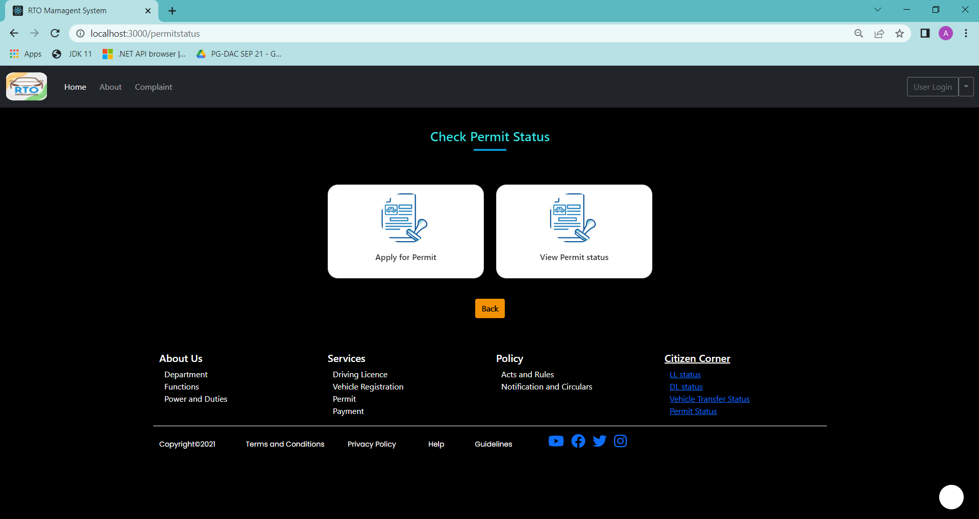
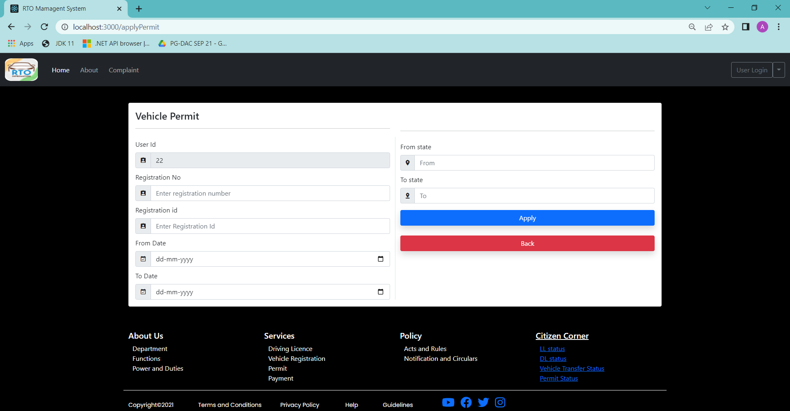

Slide 22
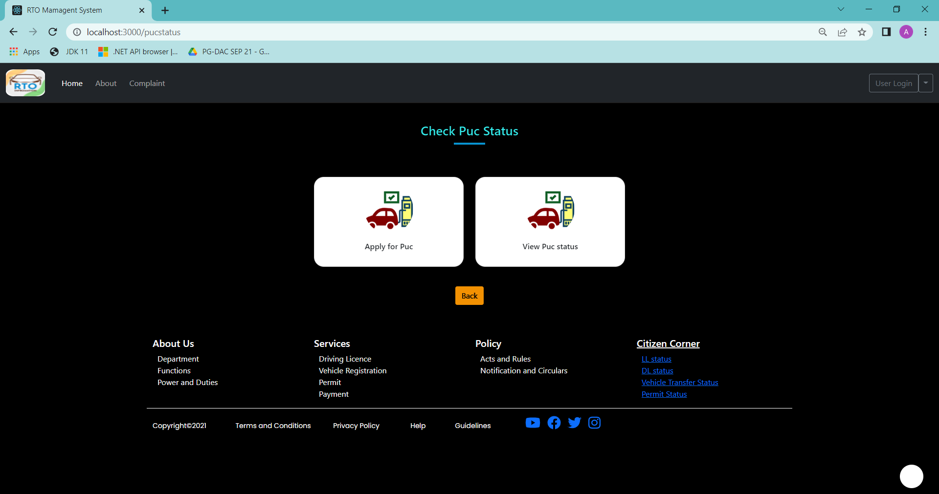
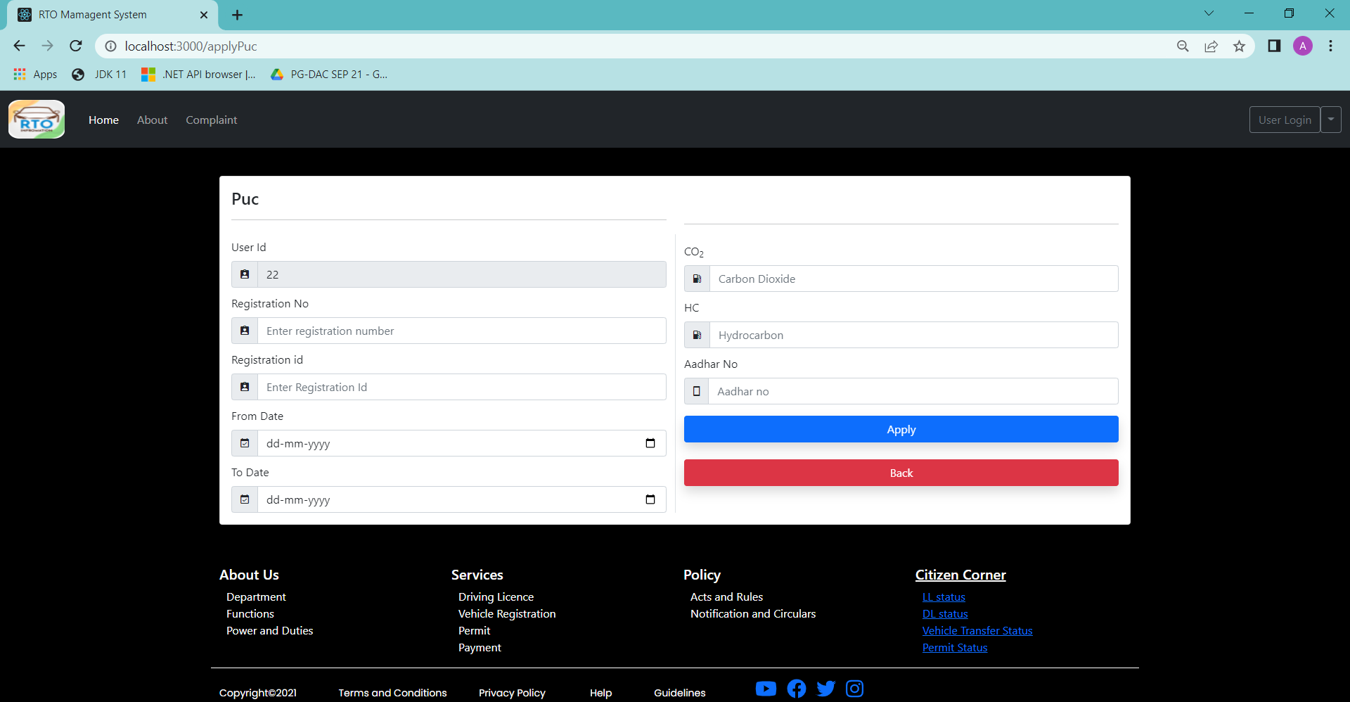

Slide 23
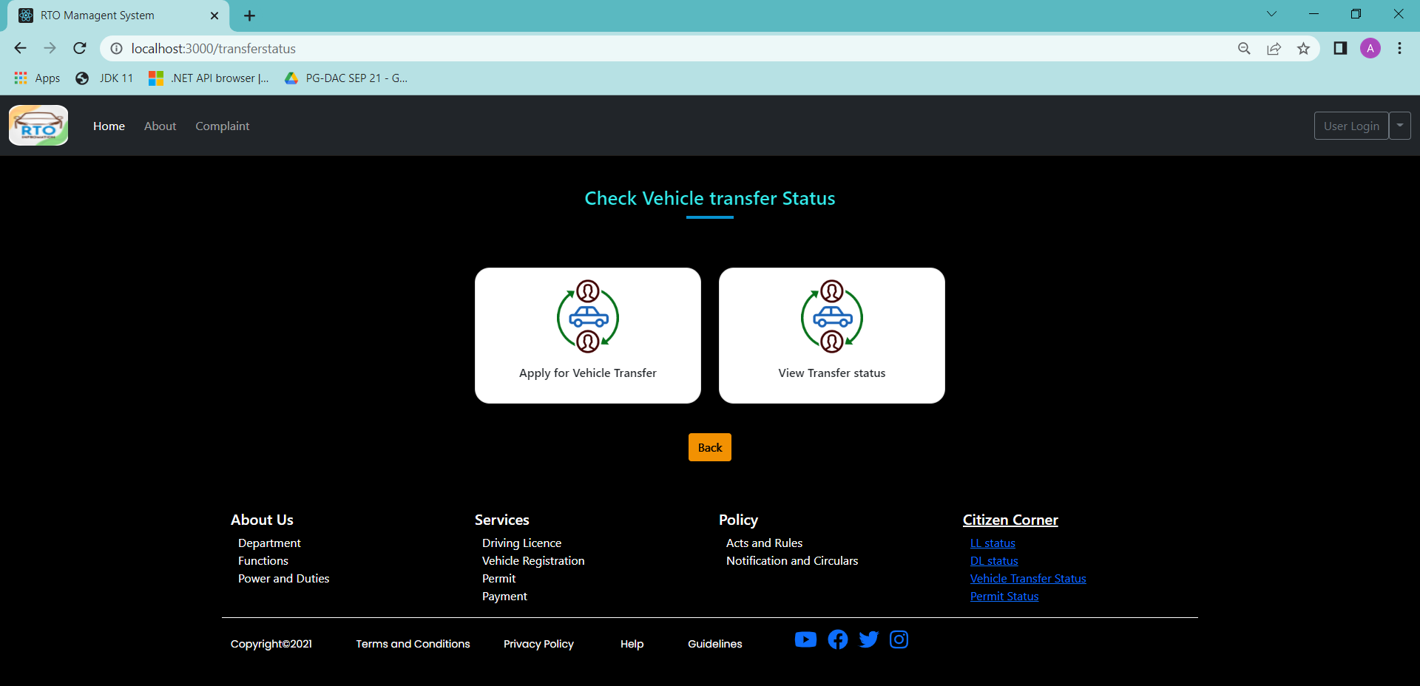
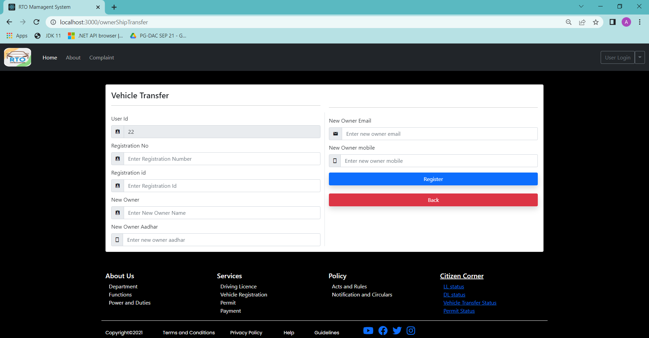

Slide 24
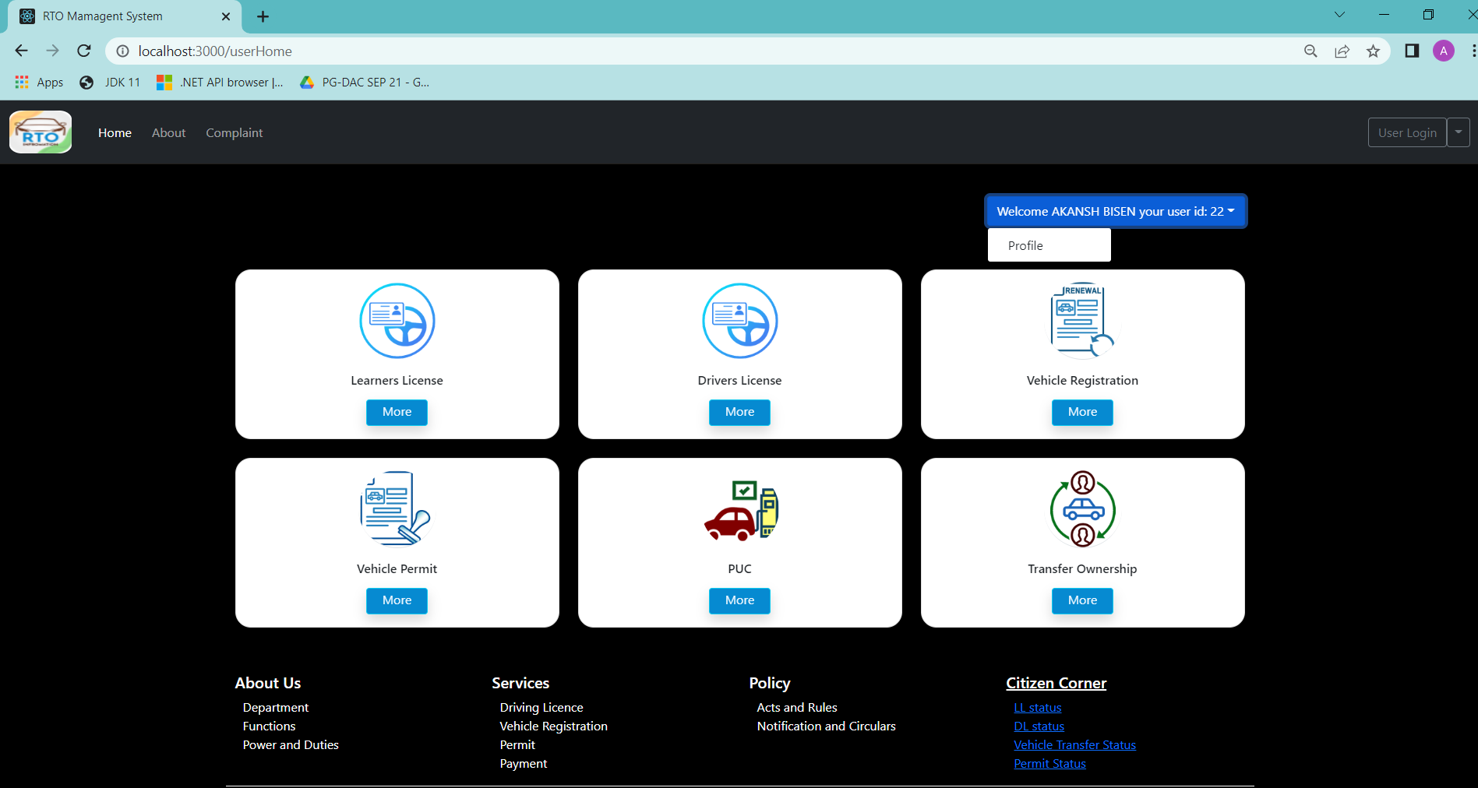
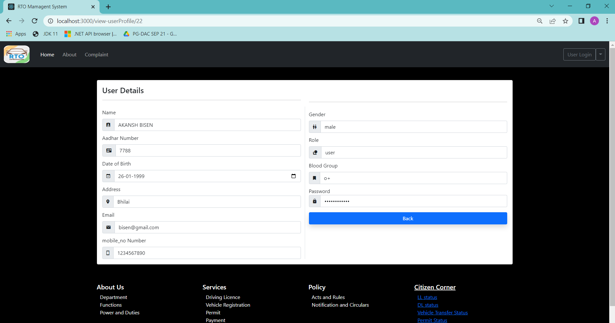

Slide 25
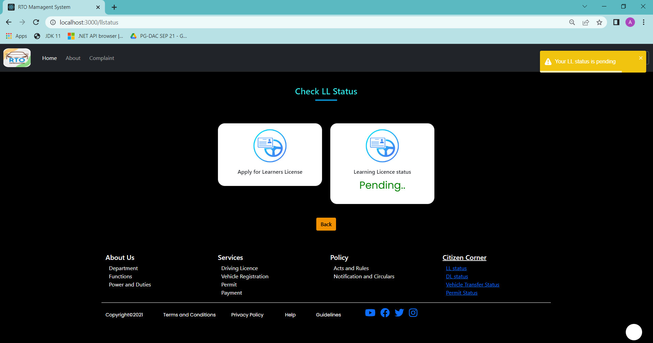
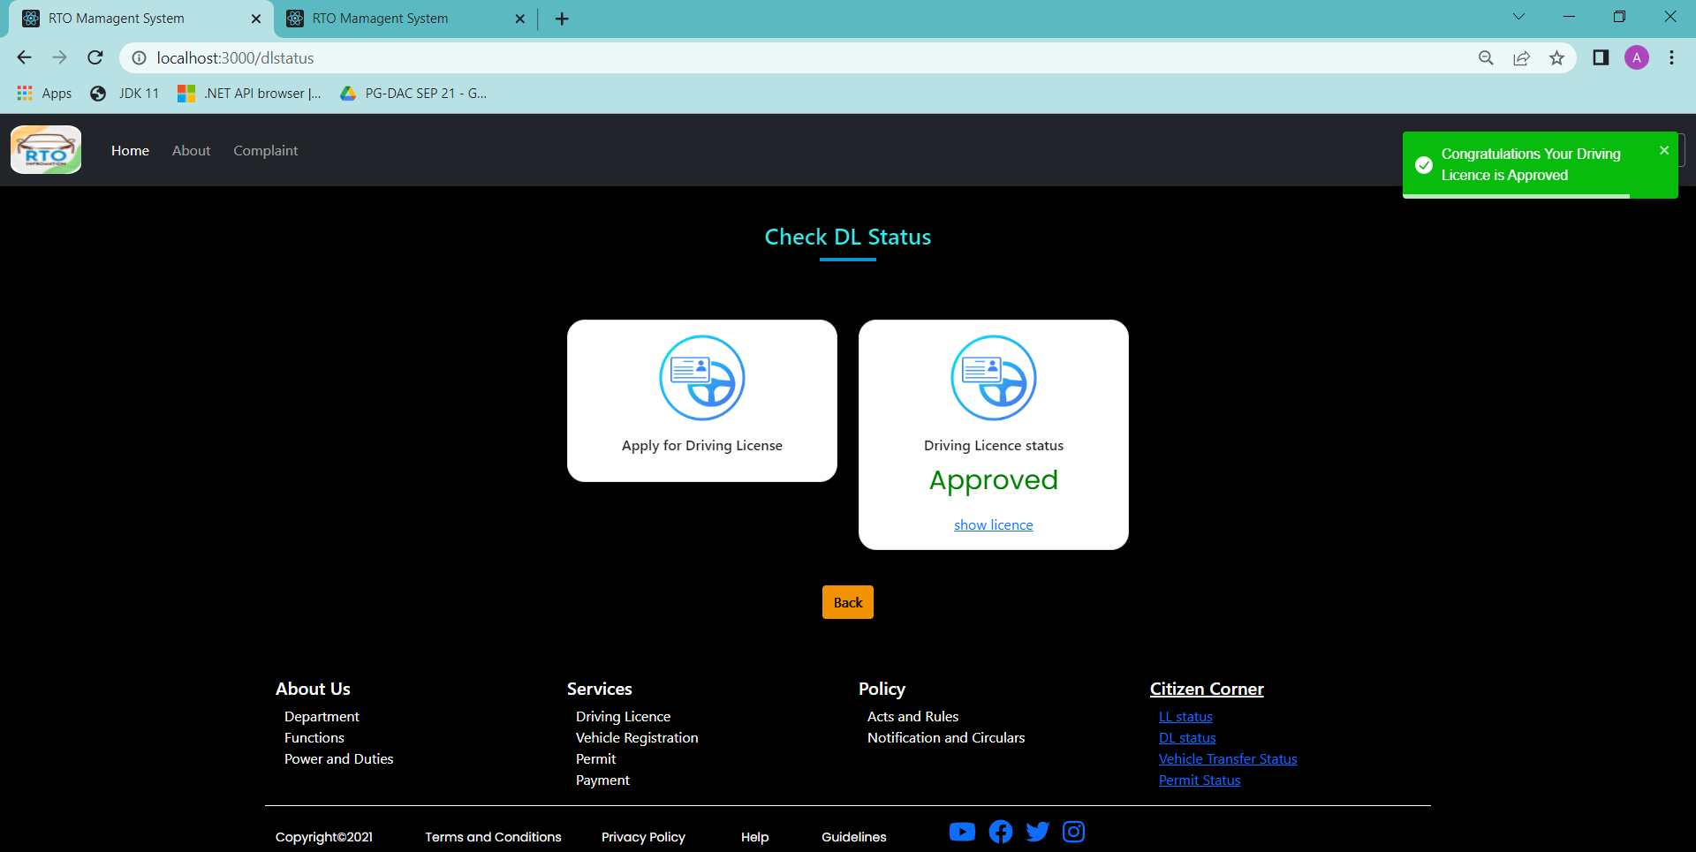

Slide 26
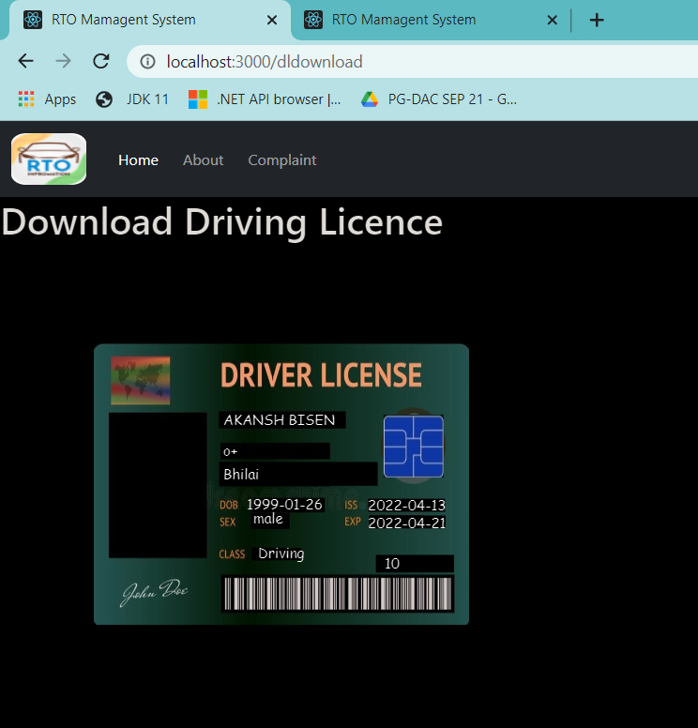
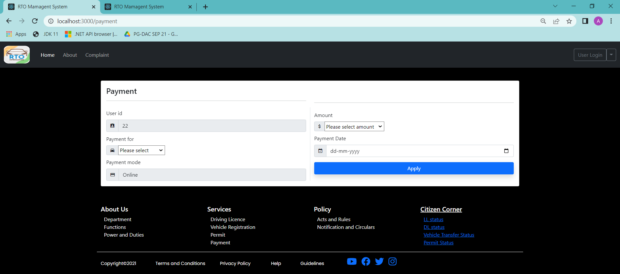

Slide 27
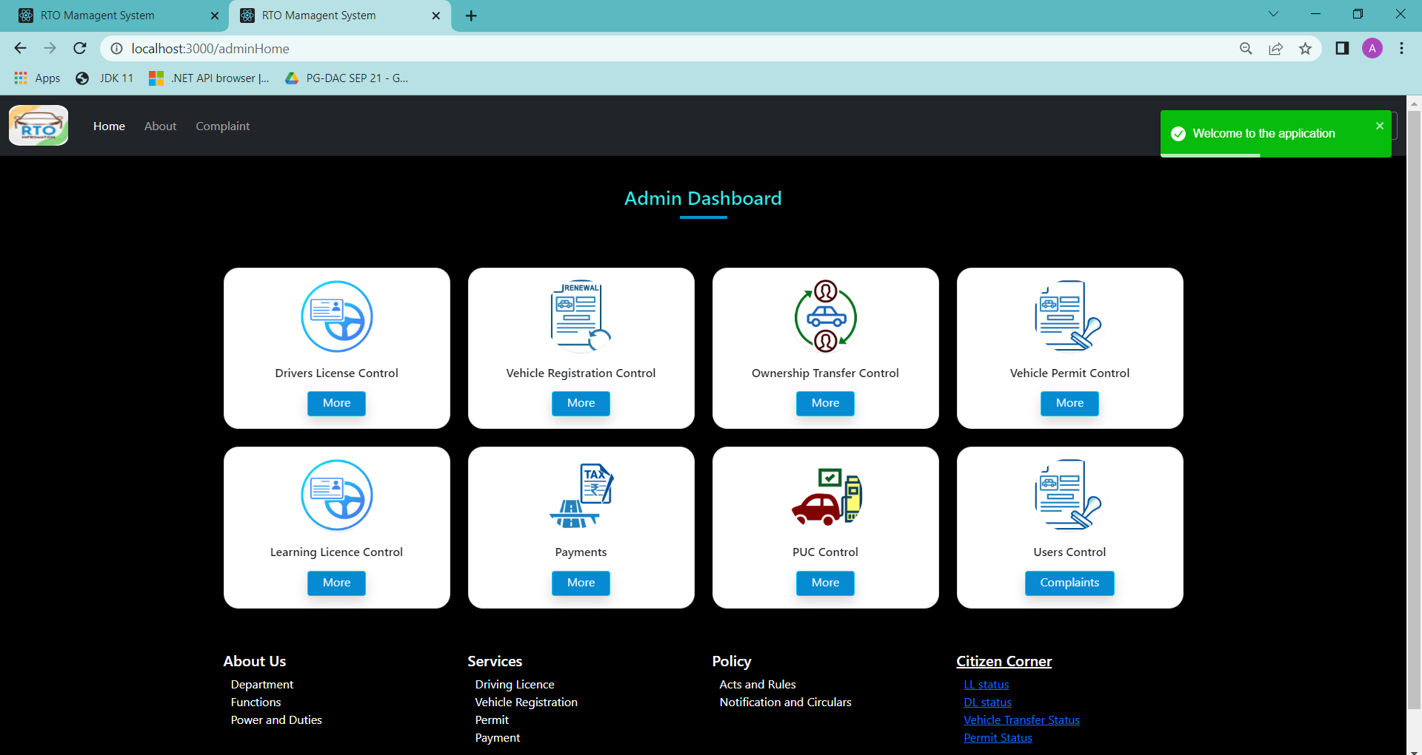
Admin Dashboard

Slide 28
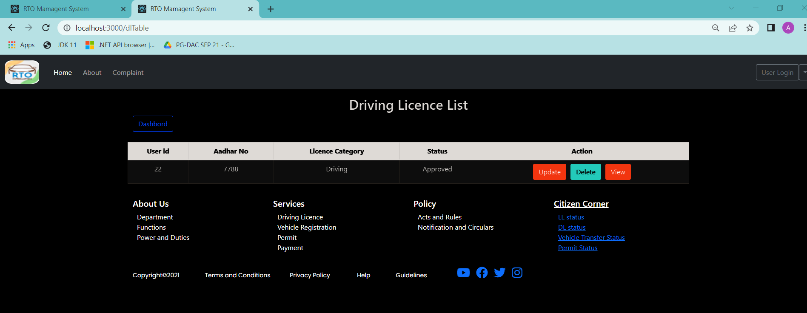
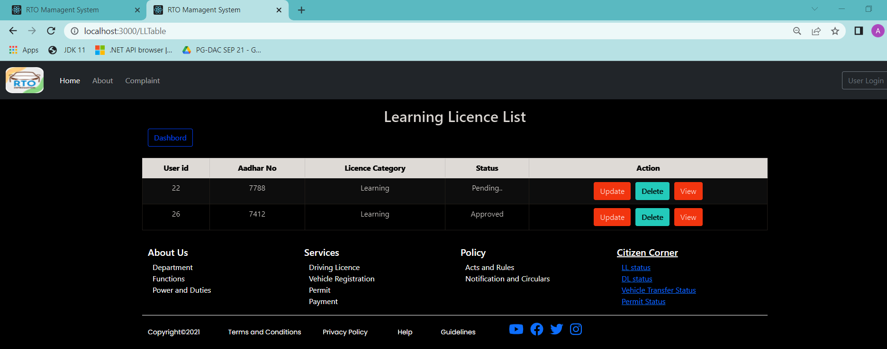

Slide 29
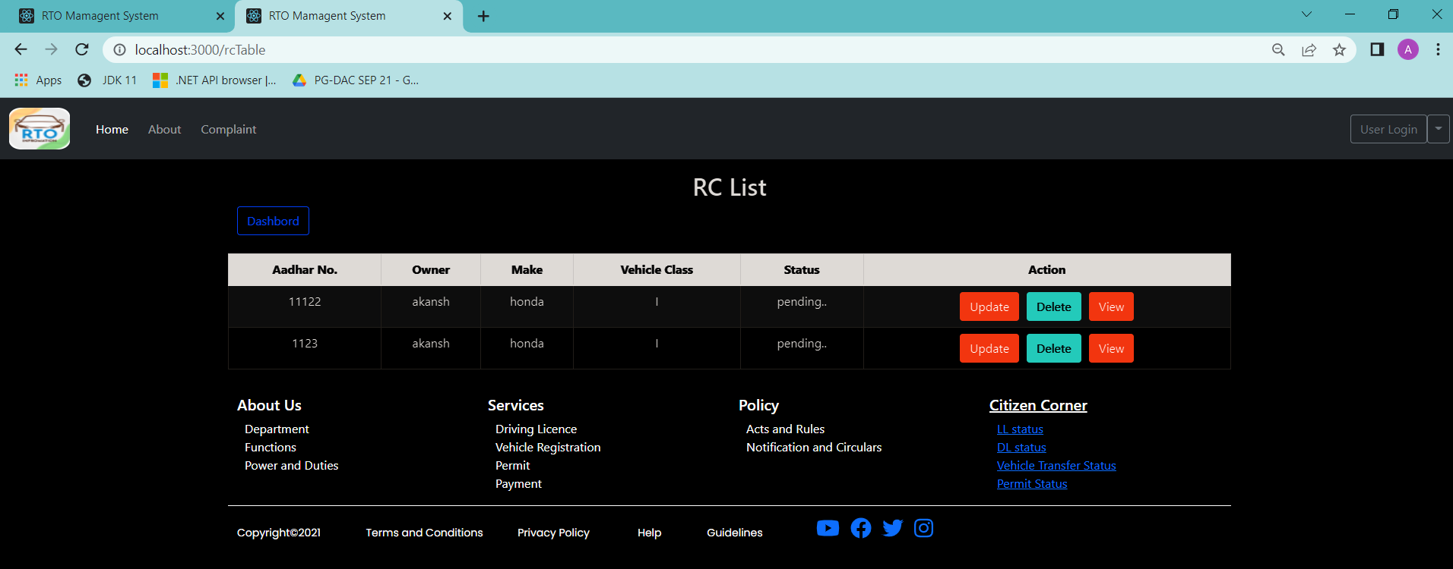
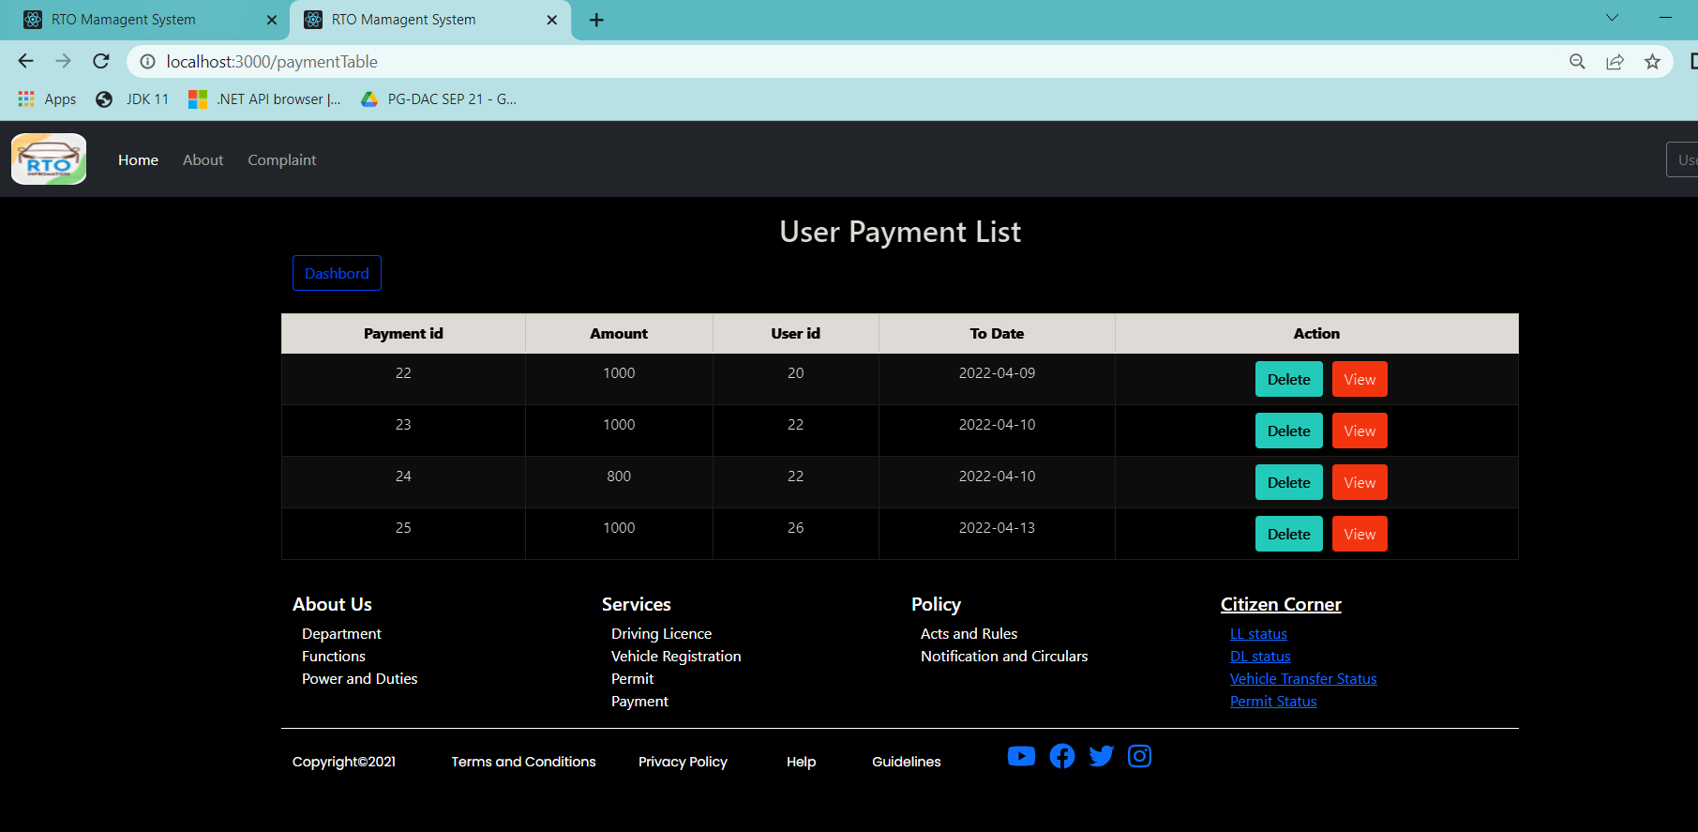

Slide 30
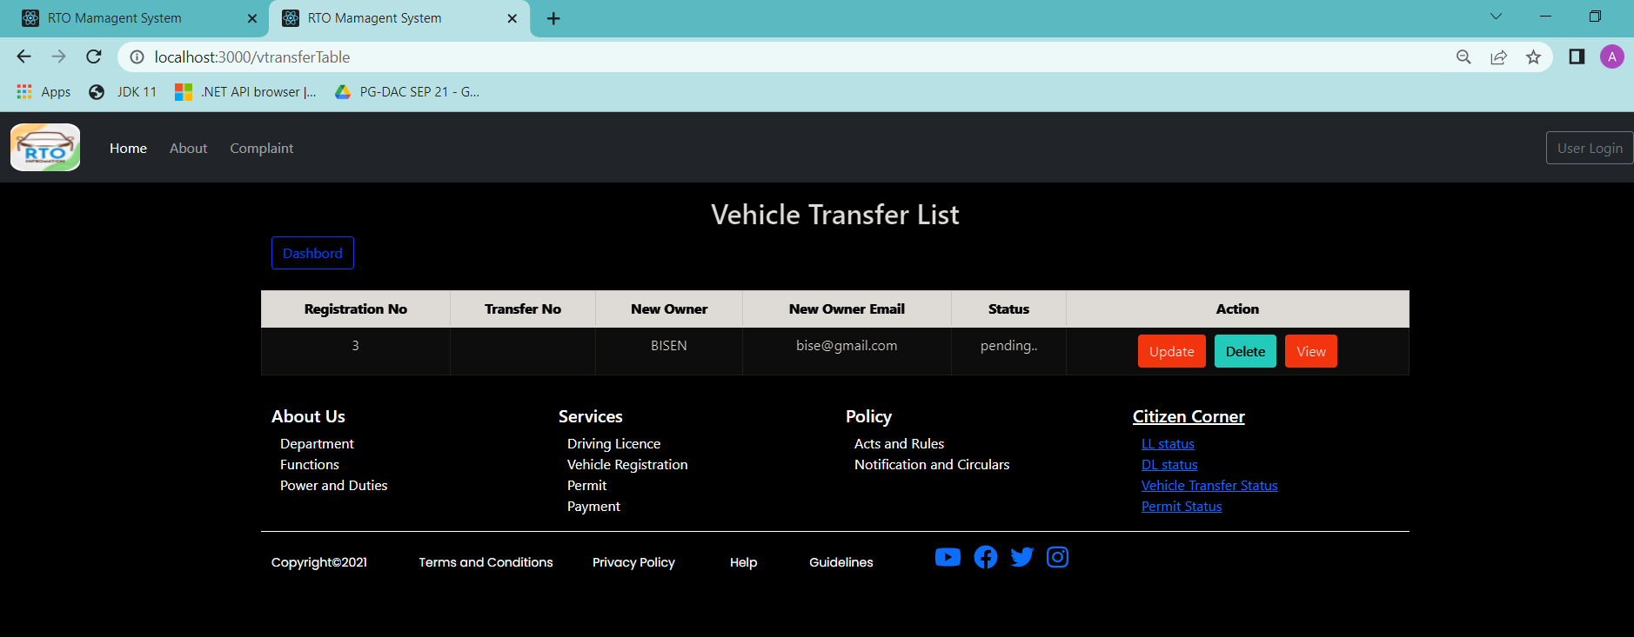
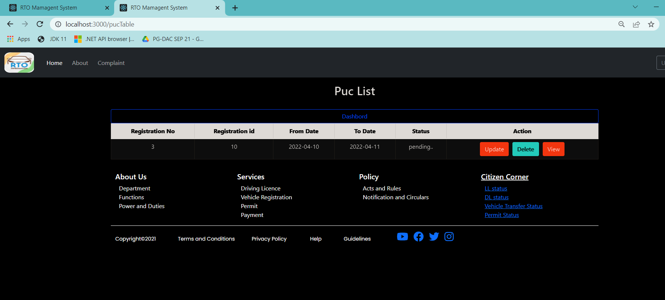

Slide 31
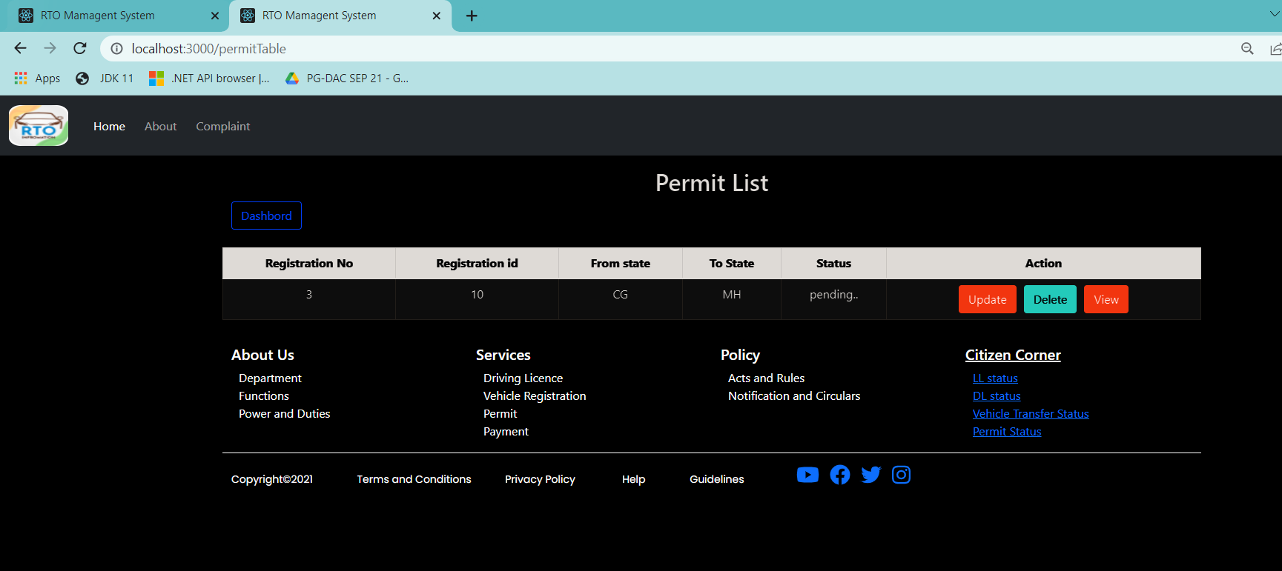
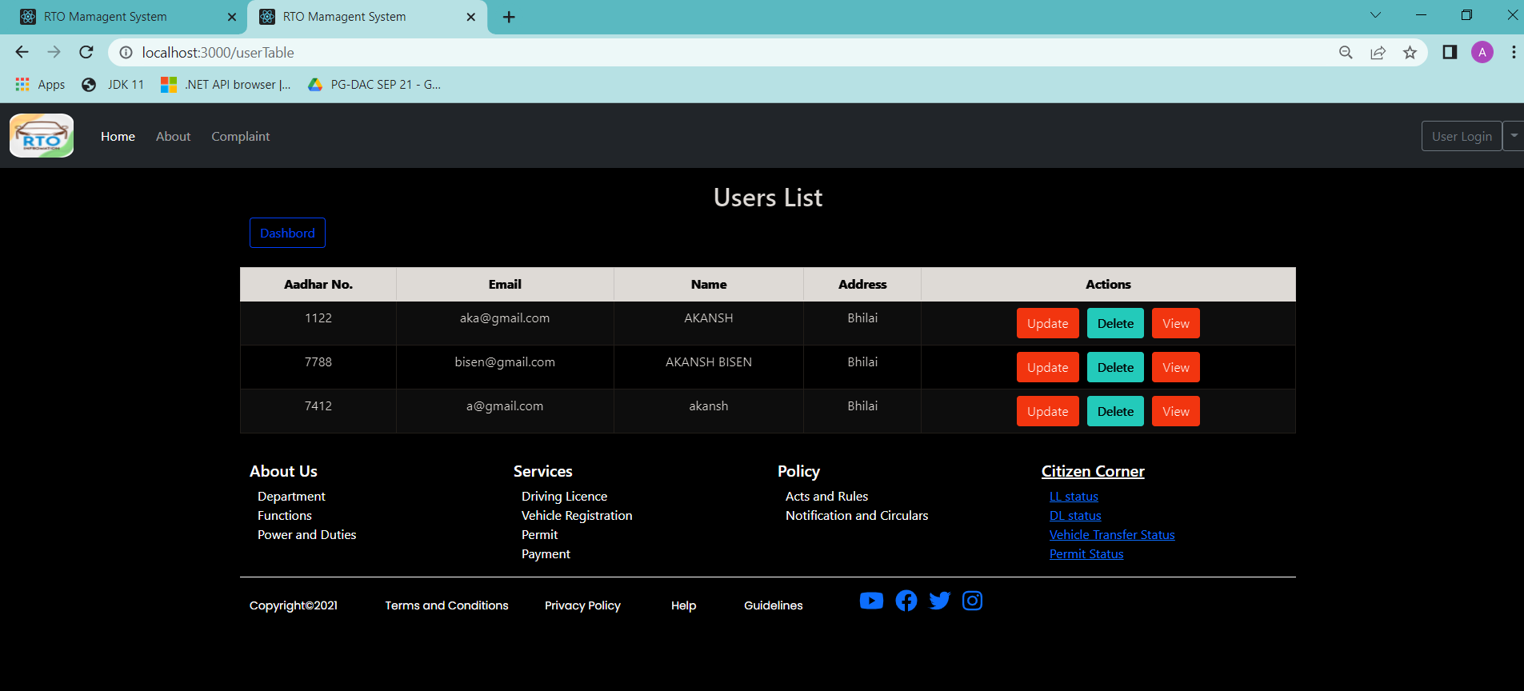

Slide 32
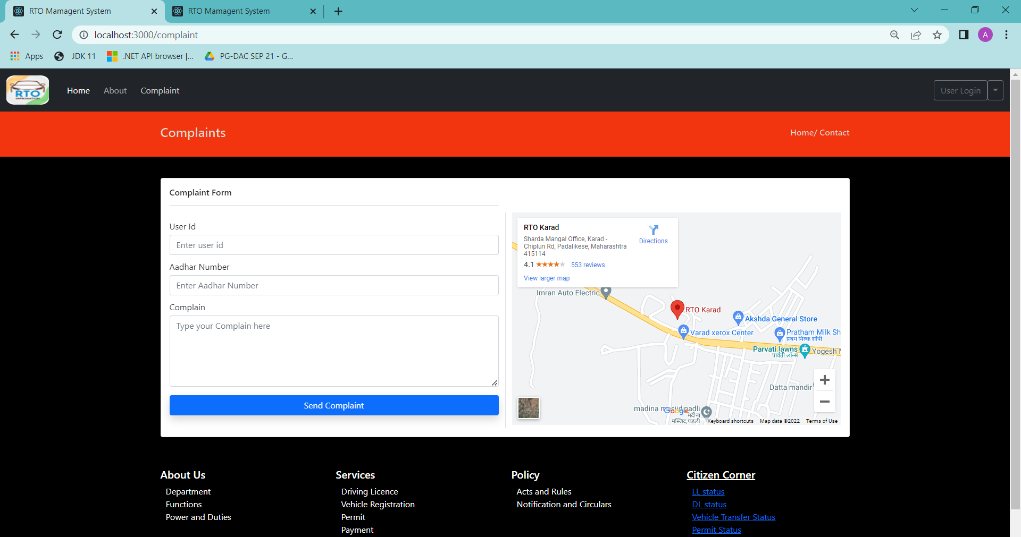
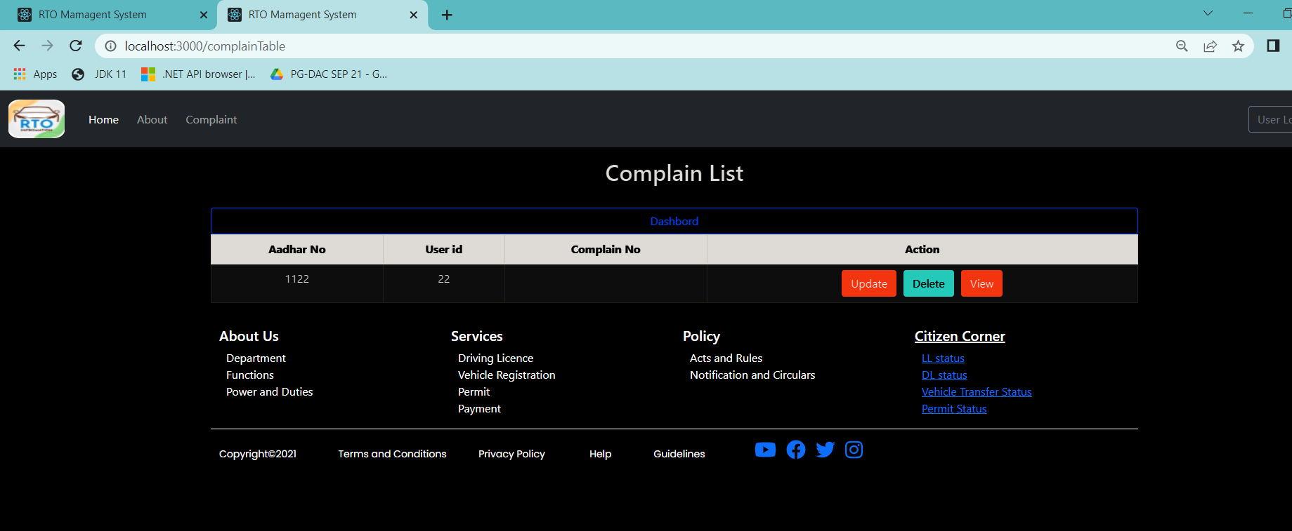

Slide 33
s/w and h/w requirements
Hardware Requirement:
RAM | 4 GB
Hard Disk | 500 GB
Processor | Quad Core
Software Requirement:
Client Side
Server Side
Web Server | TOMCAT
Server-Side Language | React
Database | MySQL
Web Browser | Google Chrome or any compatible browser
Operating System | Windows or any equivalent OS
Web Browser | Google Chrome or any compatible browser
Operating System | Windows or any equivalent OS

Slide 34
Future enhancement
This project can be enhanced further by adding mailing services for each approved functionality, PDF download facility for the users to download their details online without going to RTO office for physical copy. The software is flexible enough to be modified and implemented as per future requirements. We have tried our best to present this free and user–friendly website.

Slide 35
conclusion
It can be concluded that our project "RTO Management System" which is an Automation of Road Transport Department was successfully developed and tested by our team. Our system introduces a facility for the RTO Officers to perform verification of the License and Vehicle documents electronically. It will also help the RTO officials to maintain records systematically and reduces a lot of paper work and manual efforts. We also identified some general requirements of such a system and tried to meet those requirements as much as possible.

Slide 36
References
https://docs.oracle.com/en/java/javase/11/docs/api/index.html
https://getbootstrap.com/docs/4.6/getting-started/introduction/
https://www.w3schools.com/
https://reactjs.org/docs/getting-started.html
https://www.javatpoint.com/java-mail-api-tutorial

Slide 37
Git repository link
https://github.com/akanshbisen/rto_management_system.git

Slide 38
Thank you

